Slide 1



U.S. Healthcare Dynamics
View in Power BI
Last data refresh:
4/9/2025 3:13:45 AM UTC
Downloaded at:
4/9/2025 3:35:20 AM UTC

Slide 2
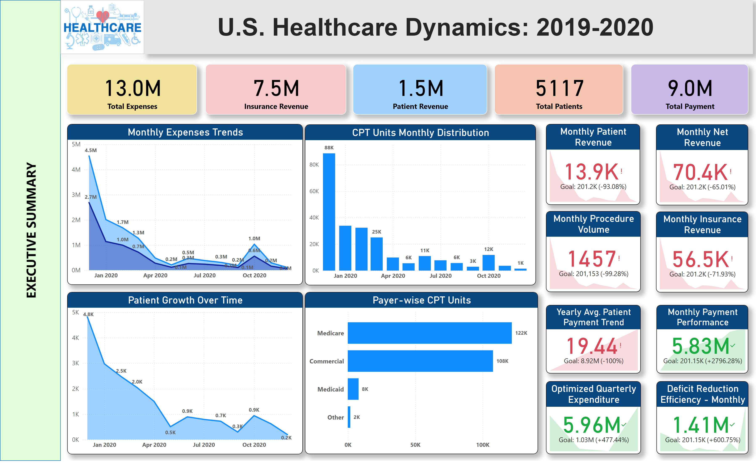
Executive Summary
Notes:
shape
No alt text provided
shape
No alt text provided
card
No alt text provided
card
No alt text provided
textbox
No alt text provided
Monthly Expenses Trends
No alt text provided
Patient Growth Over Time
No alt text provided
CPT Units Monthly Distribution
No alt text provided
Payer-wise CPT Units
No alt text provided
card
No alt text provided
card
No alt text provided
card
No alt text provided
Monthly Net Revenue
No alt text provided
Monthly Insurance Revenue
No alt text provided
Monthly Patient Revenue
No alt text provided
Monthly Procedure Volume
No alt text provided
actionButton
No alt text provided
image
No alt text provided
card
No alt text provided
Yearly Avg. Patient Payment Trend
No alt text provided
Monthly Payment Performance
No alt text provided
Optimized Quarterly Expenditure
No alt text provided
Deficit Reduction Efficiency - Monthly
No alt text provided

Slide 3
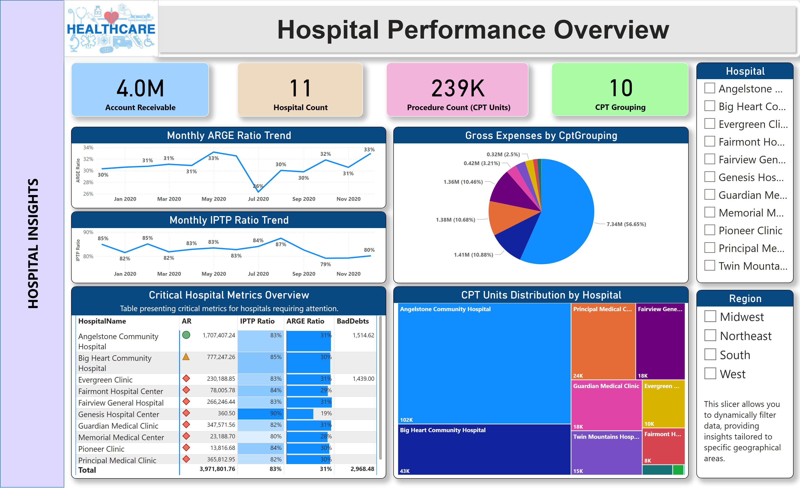
Hospital Insights
Notes:
shape
No alt text provided
shape
No alt text provided
card
No alt text provided
card
No alt text provided
card
No alt text provided
textbox
No alt text provided
Monthly ARGE Ratio Trend
No alt text provided
card
No alt text provided
card
No alt text provided
card
No alt text provided
Monthly IPTP Ratio Trend
No alt text provided
Gross Expenses by CptGrouping
No alt text provided
CPT Units Distribution by Hospital
No alt text provided
Critical Hospital Metrics Overview
No alt text provided
Hospital
No alt text provided
Region
No alt text provided
textbox
No alt text provided
image
No alt text provided

Slide 4
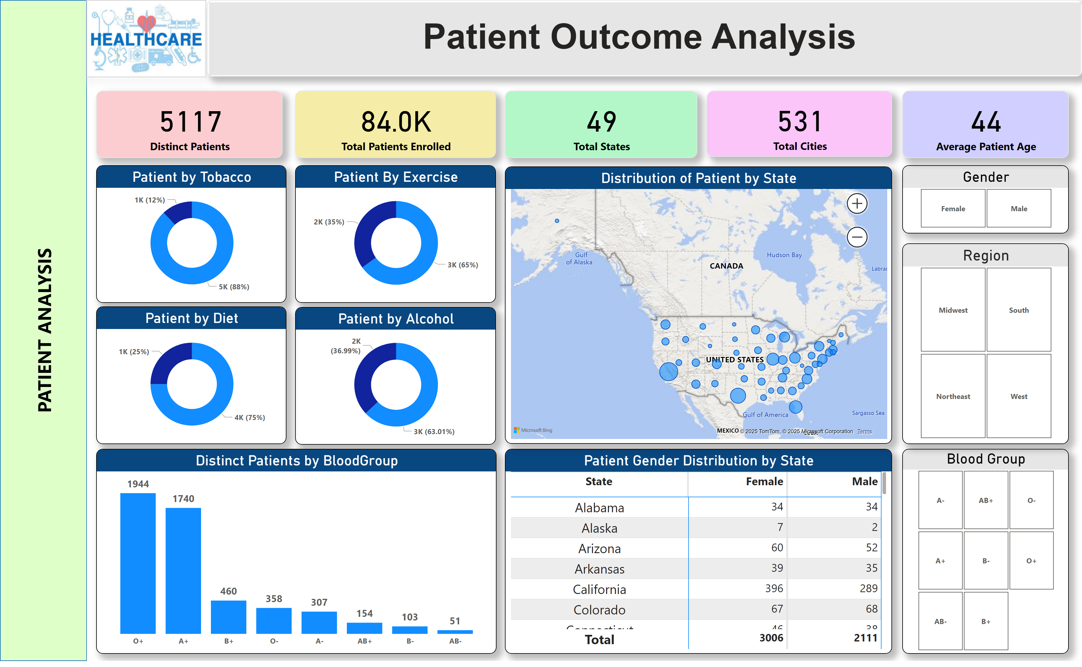
Patient Analysis
Notes:
shape
No alt text provided
shape
No alt text provided
card
No alt text provided
card
No alt text provided
card
No alt text provided
textbox
No alt text provided
card
No alt text provided
card
No alt text provided
card
No alt text provided
Gender
No alt text provided
Blood Group
No alt text provided
Patient by Tobacco
No alt text provided
Patient By Exercise
No alt text provided
Patient by Alcohol
No alt text provided
Patient by Diet
No alt text provided
Distinct Patients by BloodGroup
No alt text provided
Patient Gender Distribution by State
No alt text provided
Region Code
No alt text provided
Distribution of Patient by State
No alt text provided
image
No alt text provided
card
No alt text provided
Region
No alt text provided

Slide 5
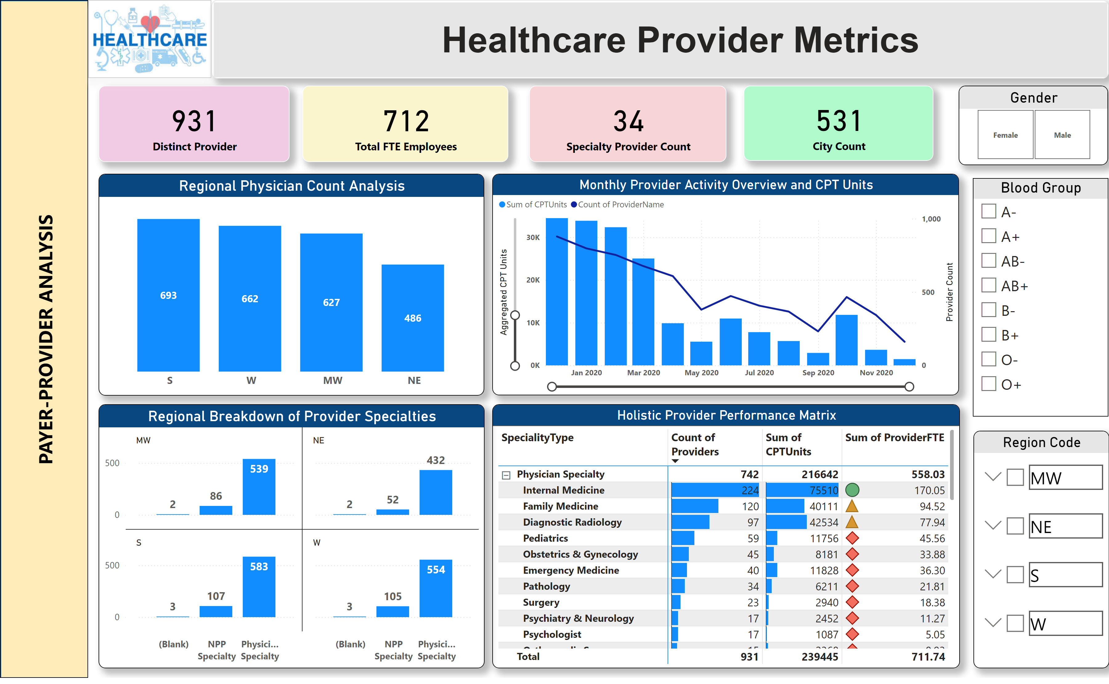
Payer-Provider Analysis
Notes:
shape
No alt text provided
shape
No alt text provided
card
No alt text provided
card
No alt text provided
card
No alt text provided
textbox
No alt text provided
card
No alt text provided
card
No alt text provided
card
No alt text provided
Gender
No alt text provided
Blood Group
No alt text provided
Regional Breakdown of Provider Specialties
No alt text provided
Regional Physician Count Analysis
No alt text provided
Monthly Provider Activity Overview and CPT Units
No alt text provided
Holistic Provider Performance Matrix
No alt text provided
image
No alt text provided
Region Code
No alt text provided

Slide 6
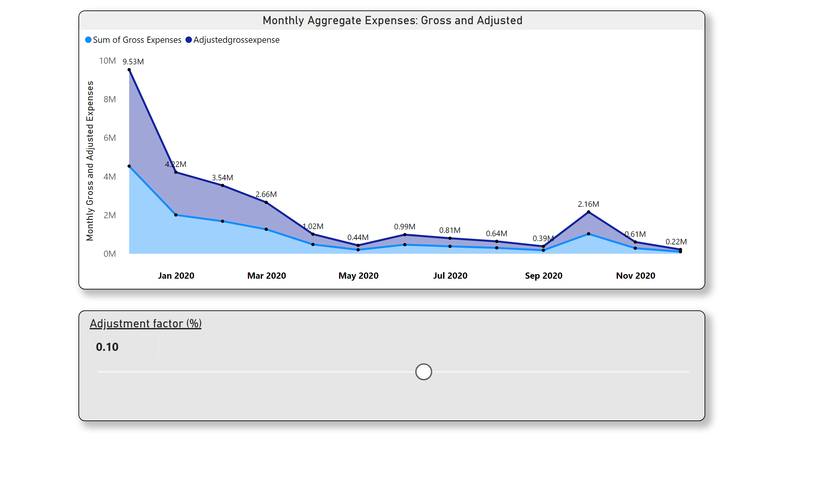
Monthly Expenses Trends
Notes:
Monthly Aggregate Expenses: Gross and Adjusted
No alt text provided
slicer
No alt text provided

